Slide 1
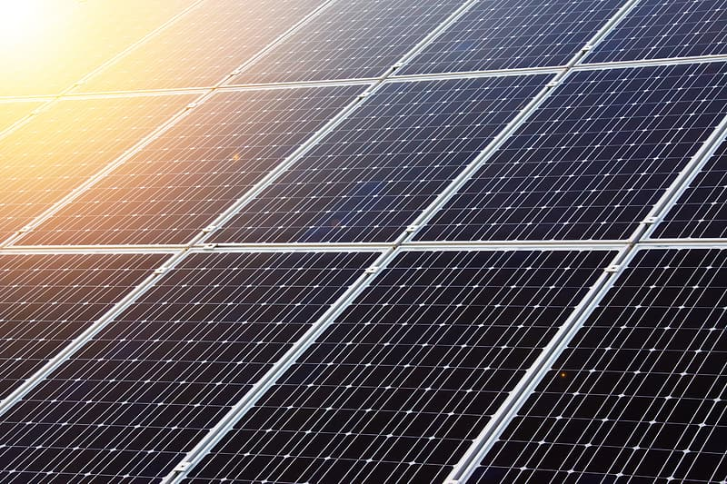
AI BASED SOLUTION FOR CLEANING DUST ON SOLAR PANEL SURFACES
Rajat Mishra -R177219141
Rajat Matella -R177219140
Rohan Nyati -R177219148
AI&ML Batch -5

Slide 2
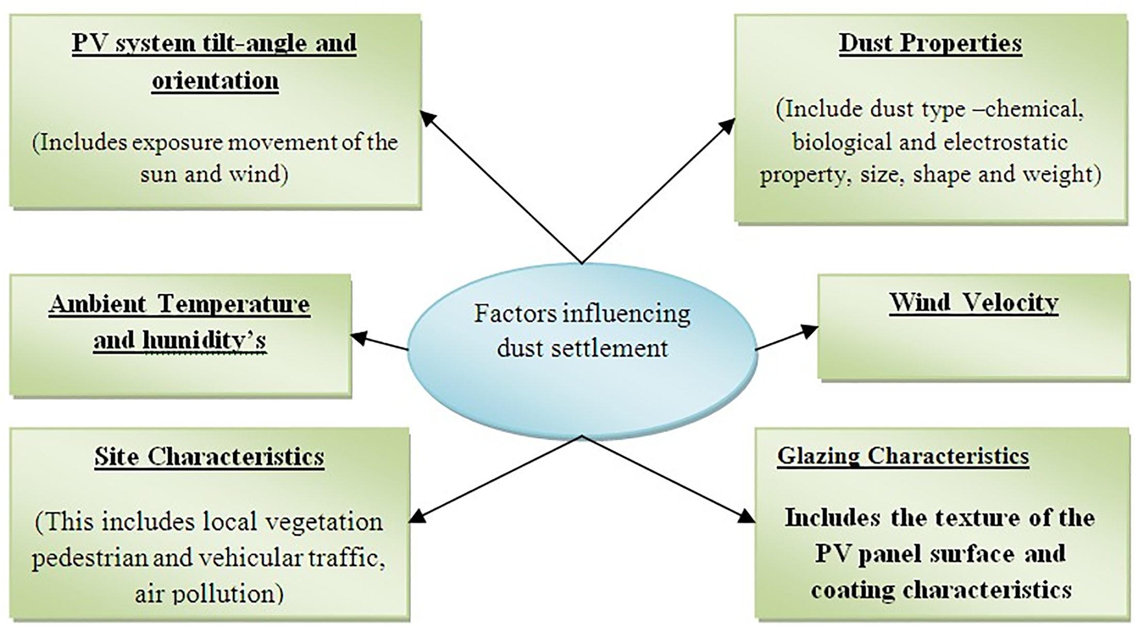

Slide 3
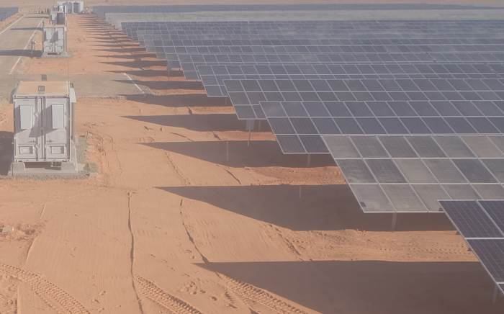
Why is dust such a big challenge for Solar Industry?
The tilt angle of the solar cell panels affects considerably the amount of accumulated dust on the surface of the panels.
The reduction in solar efficiency due to dust on PV panel is approximately 40%.The efficiency loss is significant of large of annual monetary losses.
The main cause of the reduction of solar cells power is the attenuation in transmittance of light due to the dust accumulation on the glass cover.

Slide 4
DESIGN:
OPTICAL DUST SENSOR
WATER SPRAY UNIT
It acts as a server and analyses the input from the sensors
POWER OUTPUT DETAILS
MOBILE APP/BROWSER
MICROCONTROLLER UNIT

Slide 5
Process:
1.MONITORING THE PANELS USING SENSOR:
Many autonomous systems can detect the presence of dust on the surface of solar panel
which affects its power output. So for sensing the dust on the solar panel we will be using
a OPTICAL DUST SENSOR which is able to detect very fine dust particles and even can sense the air quality around.
We will also be using the power output details of the panel. This power and energy details of the panel will help us identify the dust particles on each individual solar panel.
All of the data from the sensor is fed to the micro-controller for further analysing it.

Slide 6
The CLEANING PROCESS:
After getting the details from the sensor the microcontroller which analyses the data on the basis of a generic algorithm and if it detects the dust particles then it triggers the spray
unit.
START
ALL of the data from the sensors is sent to the microcontroller through the nodes built in it and after the controller extracts meaningful information from the data it it triggers the water spray unit with the help of a network protocol
like MQTT and also with the app interface.
Monitoring for dust particles
If dust detected
NO
YES
Trigger the water spray unit.

Slide 7
ADVANTAGES OF USING WATER SPRAY UNIT OVER ROBOT:
1.Cost Efficient:
The water spray unit connected to each column in the network of the solar panels will be cost efficient as compared to an autonomous cleaning robot.
2.Power Efficient
3.We will also using a water channel that run pasts the panels which collects the water sprayed on and takes it to a storage tank so that the water can be recycled and can be used again for the purpose of cleaning.

Slide 8
Thank You

